Slide 1
Main Title Slide
TDX Powerpoint Template

Slide 2
Section Header
How to use Templates
Using templates
How to use page masters
Why you never change a font size
2020 Powerpoint changes

Slide 3
Using Templates
This side box can contain
many things
  Lists
  Pictures
  Charts
  Video
This is a page where you can enter text below the title

Slide 4

Using Templates
This is a page where you can add a caption to a photograph or other relevant content.
You click the icon and choose the picture.
In Powerpoint often you will get “Design Ideas” please don’t use them.

Slide 5
Using Templates
This is a two column layout Boxes can be used for many things
  Charts
  Graphs
  Photos
  Movies
This is a two column layout Boxes can be used for many things
  Charts
  Graphs
  Photos
  Movies

Slide 6
How to use page masters
This side box can contain
many things
  Lists
  Pictures
  Charts
  Video
This is a page where you can enter text below the title

Slide 7
Constancy matters
This layout is for longer lines of copy and should fit the maximum amount of copy used on a slide
Fonts have been chosen
Colors have been selected
Layouts are constant
  Header
  Footer
    Date
    Web address
    Page number

Slide 8

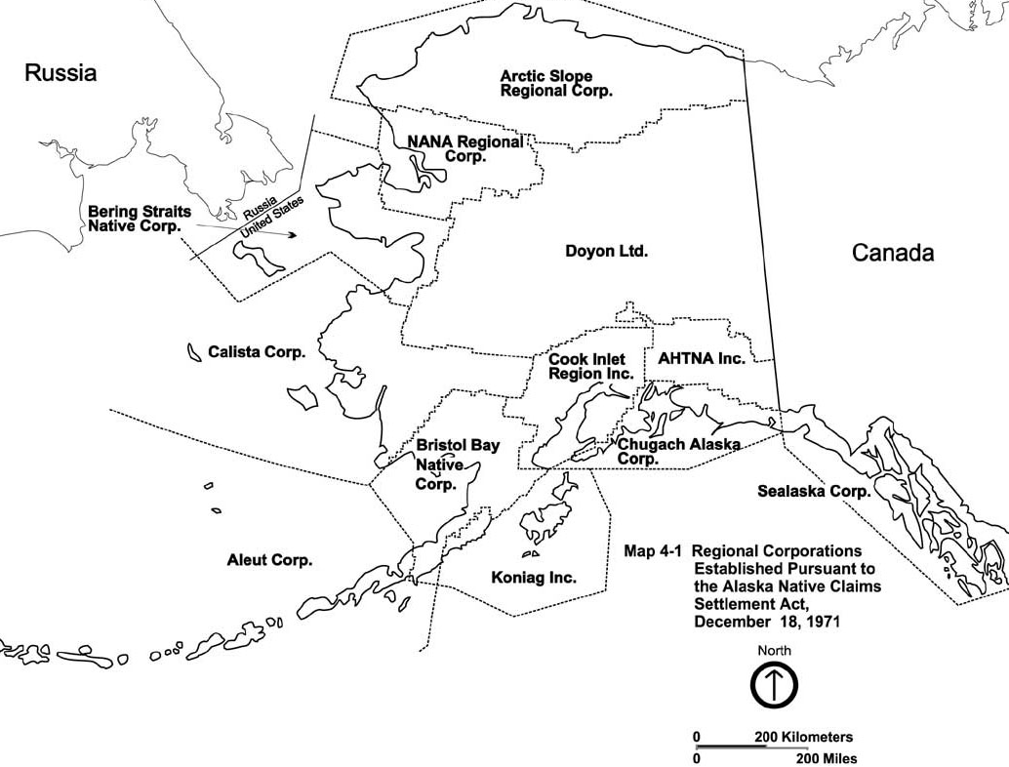
This page is good for two images
Or Charts
Or graphs

Slide 9
Why you never change a font size
Constant size across all pages
Use of indent buttons will automatically change font size
If you have too much content to fit. You have too much content. Use two slides.
They will not automatically change with global adjustments

Slide 10
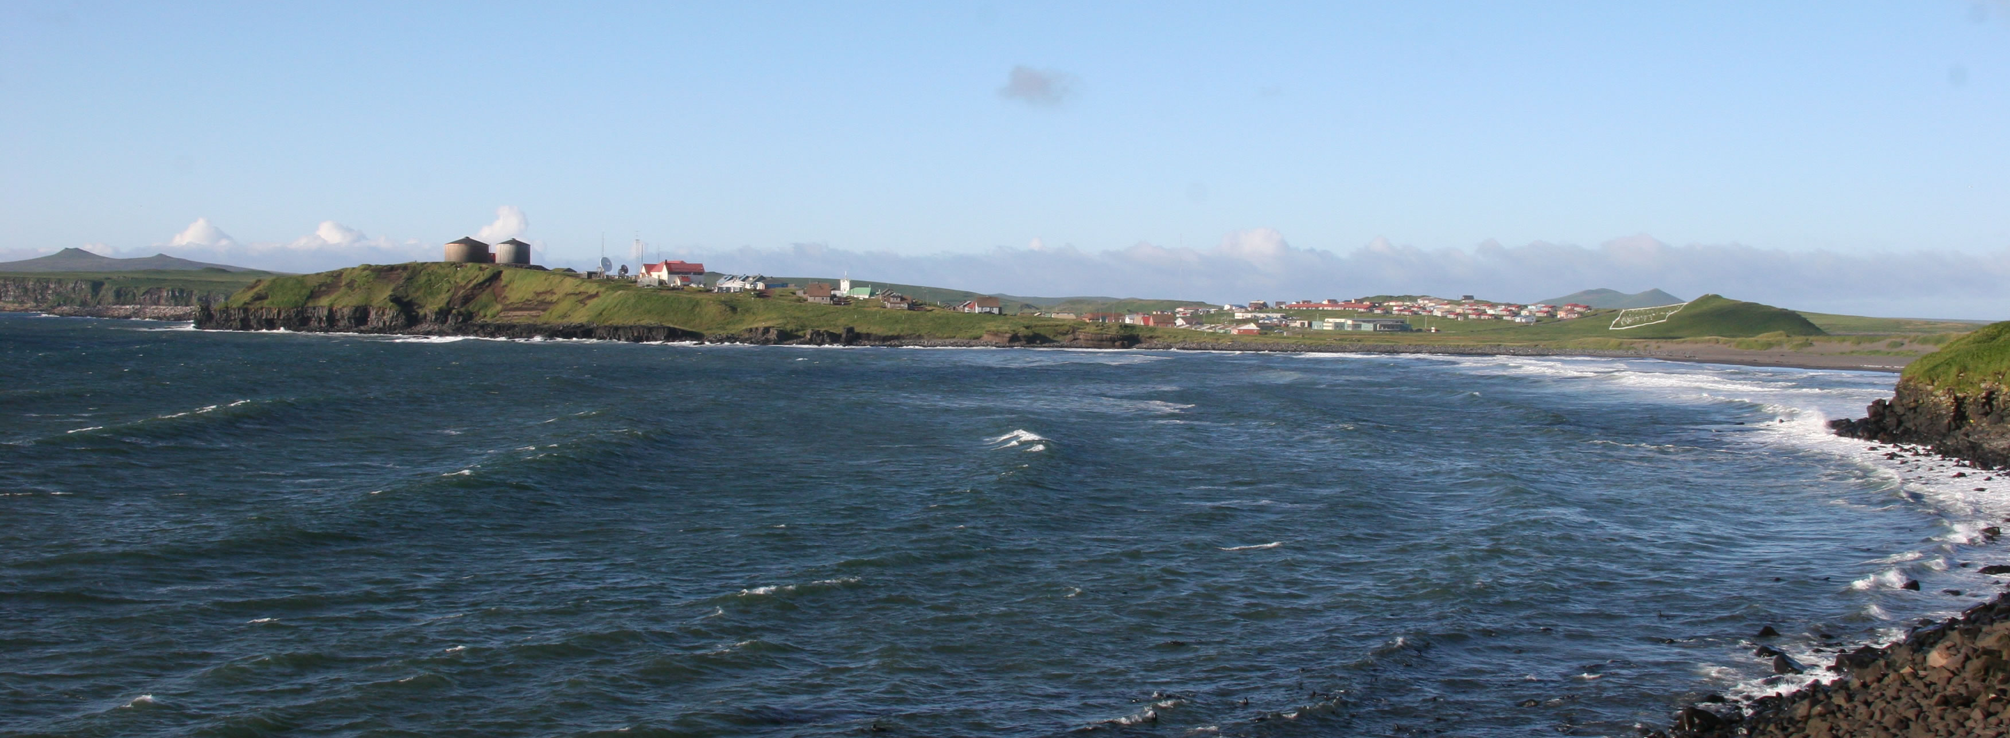
Thank you

